Slide 1
Social Media Ad Campaign
Using Microsoft Excel and Power BI

Slide 2
Introduction
Social Media Ad Campaign is a series of planned actions on social media platforms to achieve specific business goals.
A social media ad campaign dashboard is a centralized tool that provides a visual overview of key performance indicators (KPIs) for your social media advertising efforts.
Through this project we will understand and create a dashboard using Microsoft excel and power bi.

Slide 3
Dataset
For this project we are using the dataset from the Kaggle data set Sales Conversion Optimization by GOKAGGLERS.
Link: https://www.kaggle.com/datasets/loveall/clicks-conversion-tracking
This dataset comprises of 1143 entries and 11 columns.

Slide 4
Methodology
Data cleaning and analysis: Microsoft Excel
Data visualization: Microsoft Power BI

Slide 5
Data cleaning and analysis
On studying the data it is observed that there are no null or invalid type values.
But some entries have error, i.e column “Clicks” have value 0 whereas column “Total_Conversion” comprises of non zero value.
An ad cannot have positive conversions without a click so remove these entries.
The working dataset consist of 939 entries.

Slide 6
Now we will create few KPIs columns for analysis in Microsoft excel:
Conversion Rate: iferror(Approved_conversion/Total_conversion,0)
CPM (Cost Per Mille or Cost Per Thousand Impressions): Spent/(Impressions/1000)
CPC (Cost per click): iferror(spent/clicks,0)
CTR (Click-through rate): clicks/impressions
CPA (Cost per Acquisition/Action): iferror(spent/Approved_conversion,0)

Slide 7
Data visualization
In Microsoft Power BI:
Get Data – upload Excel File.
Perform ETL.
Start creating visualizations:

Slide 8
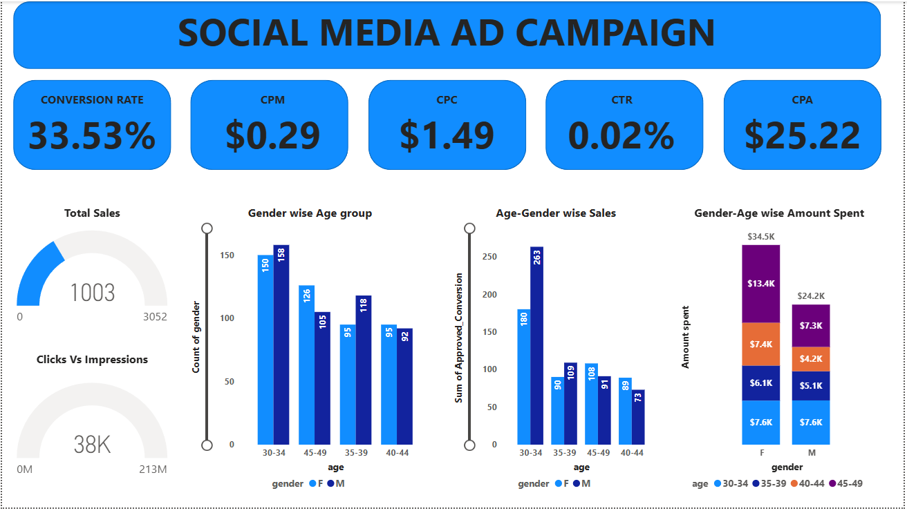
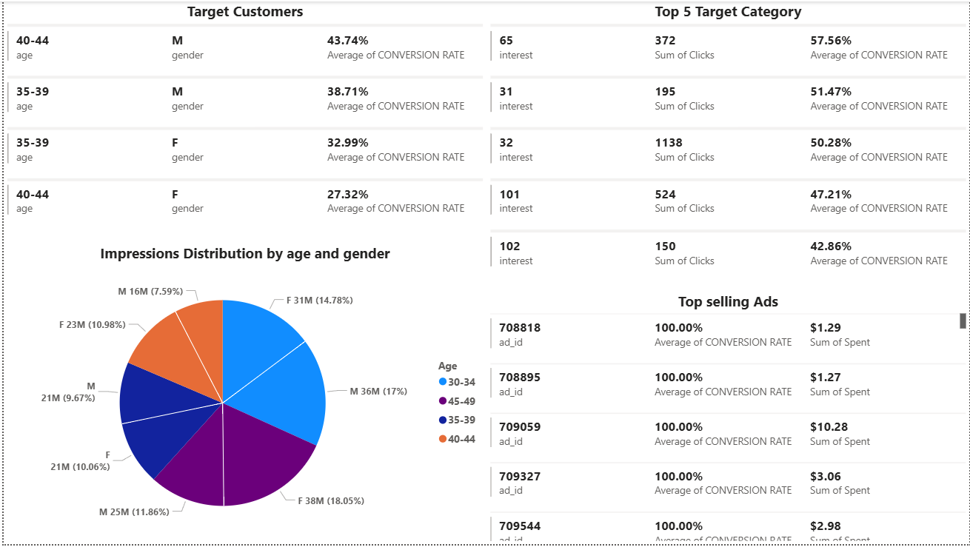
Dashboard

